Slide 1
The role of social information in cross-situational word learning
Kyle MacDonald
Developmental Brownbag
5/21/14
Notes:
Hello everyone. Thank you for coming. My name is Kyle MacDonald and I’m a first-year working with Mike. Today I’m going to talk about the role of social information in cross-situational word learning.
I should mention that this is collaborative work with my advisor Mike Frank and a post-doc in my lab, Dan Yurovsky.

Slide 2
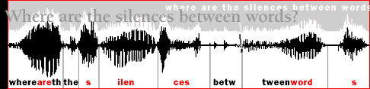

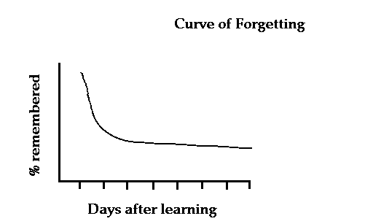
“BALL”
Notes:
To learn the meaning of a new word have to solve several inferential problems. For example, they have to extract an individual word from a continuous stream of speech, map that word to the correct object in the world, and retain that link over time.
Today I’m going to be focusing on the specific problem of how children map concrete nouns to objects in their environment. And one of the fundamental components of this puzzle is how children solve the problem of referential uncertainty.
Or what I’m going to call…

Slide 3
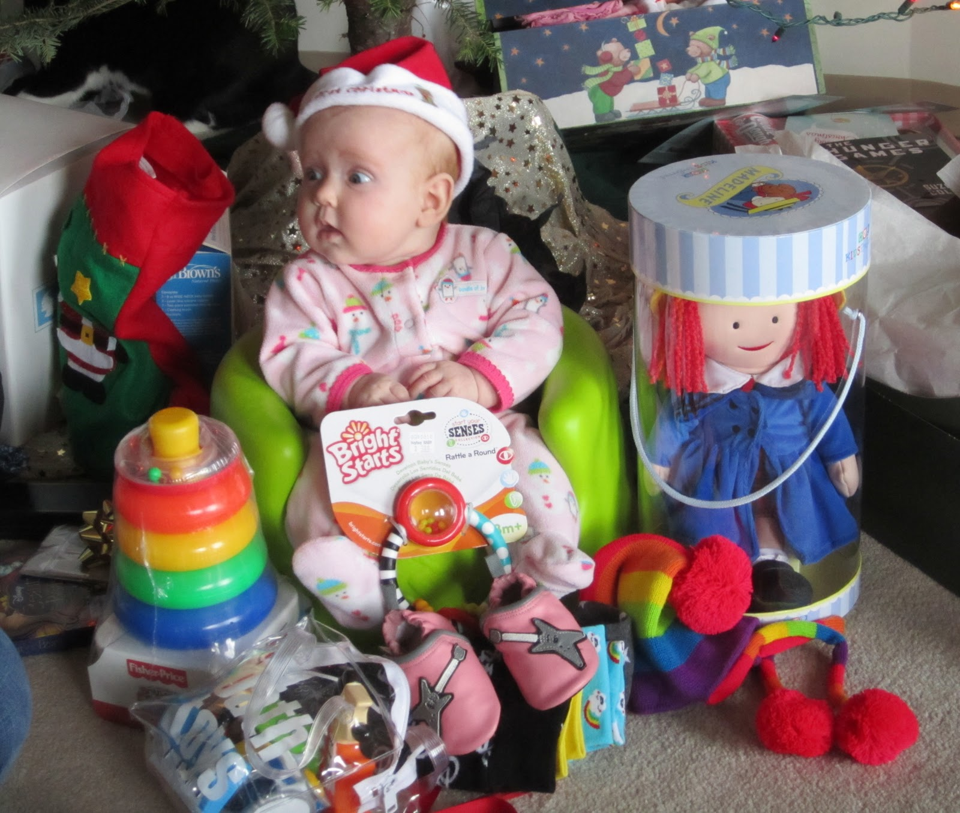
The problem of baby’s first Christmas
Dax?
Dax?
Dax?
Dax?
Quine (1960)
Notes:
“The problem of baby’s first Christmas.”
Imagine you are this child, surrounded by novel objects that you’ve only seen for a couple of minutes and you’re highly motivated to figure out the words for each object. Then mom says something like, “Hey! Do you like your new dax?” The problem here is that dax could refer to any of these toys, to some property of one of the toys, or even nothing at all.
So without any additional information, it’s probably going to be difficult to figure out which of these exciting new toys is the dax. And given your uncertainty it might make sense to keep track of the co-occurrence of ‘Dax’ and a couple of these toys and hope that more information will come in subsequent labeling events. This strategy has been called cross-situational learning.
However…

Slide 4

Notes:
What if mom hands you one particular toy and says, “Hey, do you like your new dax?”
Then, in this case perhaps you can be more confident about what she’s talking about

Slide 5
Dax?
Dax?
Dax?
Dax?
Dax?
Dax?
Notes:
Then, perhaps you can be more confident about what she’s talking about and maybe it’s not necessary to track the co-occurrence information and instead you can just keep track of the dax—duck link.
My current work takes these real-world word learning situations, which lie along a continuum of referential uncertainty – from low to high -, and brings them into the lab. And using a highly controlled experiment I want to explore how uncertainty reduction with social cues interacts with cross-situational word learning.
Here’s an overview of what I’ll be talking about today.

Slide 6
Roadmap
Different ways to reduce referential uncertainty
Debate about the process underlying cross-situational word learning
A novel, large-scale experiment and computational model
Notes:
First, I will discuss two different ways to reduce referential uncertainty
Then, I will go into more detail about a debate over the underlying process that support cross-situational learning. Specifically, whether learners are actually tracking multiple candidate word-object links over time, with the goal of situating my current work within this debate
Finally, I will present data from a large-scale experiment with adults that suggests that there is a tradeoff between reducing referential uncertainty and the strategies that learners use. I will also present a computational model that formalizes our intuitions about how social information might alter participants’ word learning.

Slide 7

Reducing uncertainty during labeling (social cues)
Baldwin (1995); Bloom (2002); Tomasello (2009)
Notes:
The first way that I will talk about is reducing referential uncertainty during labeling via social cues. This is the proposal put forth by Social-Pragmatic theories of language acquisition that argue that the word to object mapping problem is simplified because children learn words in social contexts.
So in this example, because the child and his father are mutually engaged with one object in the scene the child does not have to consider all possible word-object meanings and can just focus on inferring his father’s communicative intent.
To take advantage of in-the-moment uncertainty reduction children need to have some basic set of social-cognitive skills.
In what is now a classic study, Dare Baldwin showed that infants from a young age can use a speaker’s referential intent to learn the meaning of new words.

Slide 8


Baldwin (1991)
Notes:
The experimental set up is simple. There is a child and an adult sitting across from each other at a table with 2 novel objects on it. In the experimental condition, the speaker provides a label for the toy that is not occupying the infants' focus.
Critically, 16 to 19 month olds did not map the new word to the object they were looking at. Instead they used the adult’s eye gaze as a cue and mapped the novel word to the object other object.
Importantly, children’s ability to use social information is not just limited to stripped-down experimental tasks. Correlational work shows that children with stronger gaze-following skills learn words faster compared to children with weaker gaze-following skills.
However, not all of children’s learning experiences occur in highly social contexts, and it’s possible that very early word learners might have weaker intention-reading skills. So researchers have suggested another way that children could reduce referential uncertainty without additional cues to reference…

Slide 9
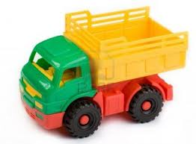

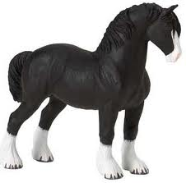
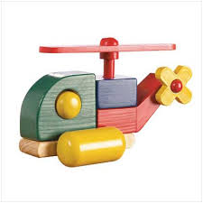
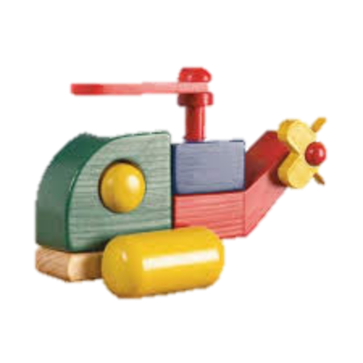
Reducing uncertainty over time (cross-situational learning)
“Truck”
Truck
2 | 1 |  | 1
 | 1 | 1
“Ball”
Ball
“Truck”
Time
Pinker (1989); Siskind (1996)
Notes:
This proposal has been called cross-situational learning. reducing ambiguity over time by aggregating co-occurrence statistics of words and objects across individually ambiguous naming events.
For example, while the word truck may occur with a truck and a ball in one situation, later on it may be heard without ball and with
other objects, like this this helicopter. Thus, over time, the word truck more likely to co-occur with the truck object.
This proposal is preferred by many researchers because it doesn’t posit additional learning mechanisms beyond associative mechanisms.

Slide 10
Cross-situational word learning
2 | 1 |  | 1
 | 1 | 1
Adults and infants can learn novel words from co-occurrence information
Computational models suggest that language-scale lexicons can be acquired using cross-situational learning
Blythe et al. (2010); Frank et al. (2009); Smith & Yu (2008); Yu & Smith (2007)
Notes:
Recent research with both adults and infants show that novel words can be learned via co-occurrence information alone. These results provide an important proof of concept, that statistical or associative learning may proceed without solving referential ambiguity in the moment via social cues.
Also, Computational models suggest that XSL can be used to accurately infer the meanings of words from small but realistic corpora of language use can allow large, language-scale lexicons to be learned in the face of considerable referential uncertainty (Blythe, Smith, & Smith, 2010).

Slide 11
In-the-moment
Over time
“Truck”
“Ball”
“Truck”
Notes:
So there is evidence that referential ambiguity can be reduced at two different time scales: in-the-moment with social cues AND over-time with cross-situational statistics.
My current work asks how these two sources of information interact to support learning. Does the presence of social cues alter cross-situational learning?

Slide 12
Roadmap
Different ways to reduce referential uncertainty
Debate about the process underlying cross-situational word learning
A novel, large-scale experiment and computational model
Notes:
Part of the motivation for this work comes from the debate over the process underlying cross-situational learning, so I just want to introduce this debate.

Slide 13
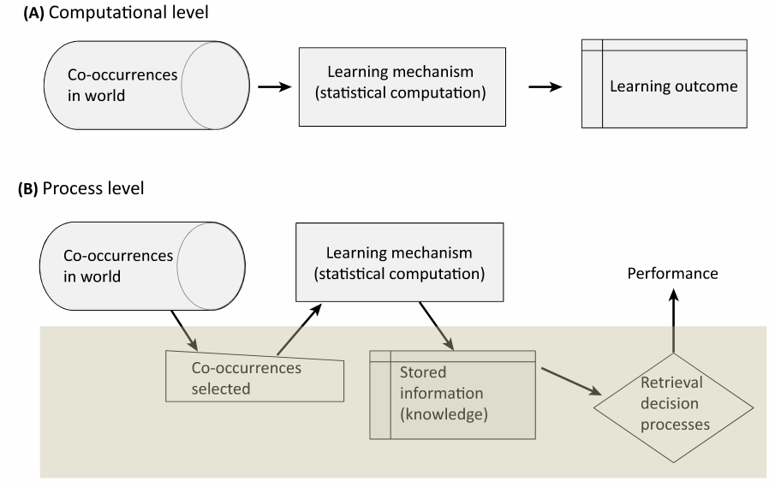
Smith, Suanda & Yu (2014)
Notes:
Generally, proponents of cross-situational learning agree on the computational problem that learners are solving. Input are the co-occurrences in the world. There is some learning mechanism that performs computations over that input, leading to learning.

Slide 14
Smith, Suanda & Yu (2014)
Notes:
Where people disagree is at the process level. What are the actual representations stored in memory and how are those representations updated as more information coming along.
The two proposals are…

Slide 15
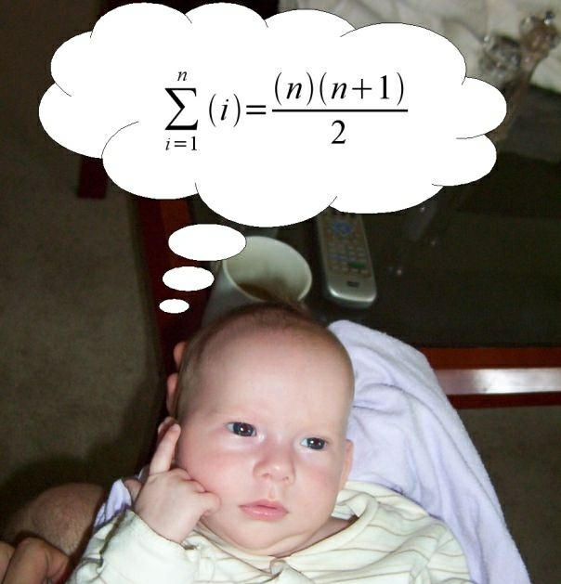
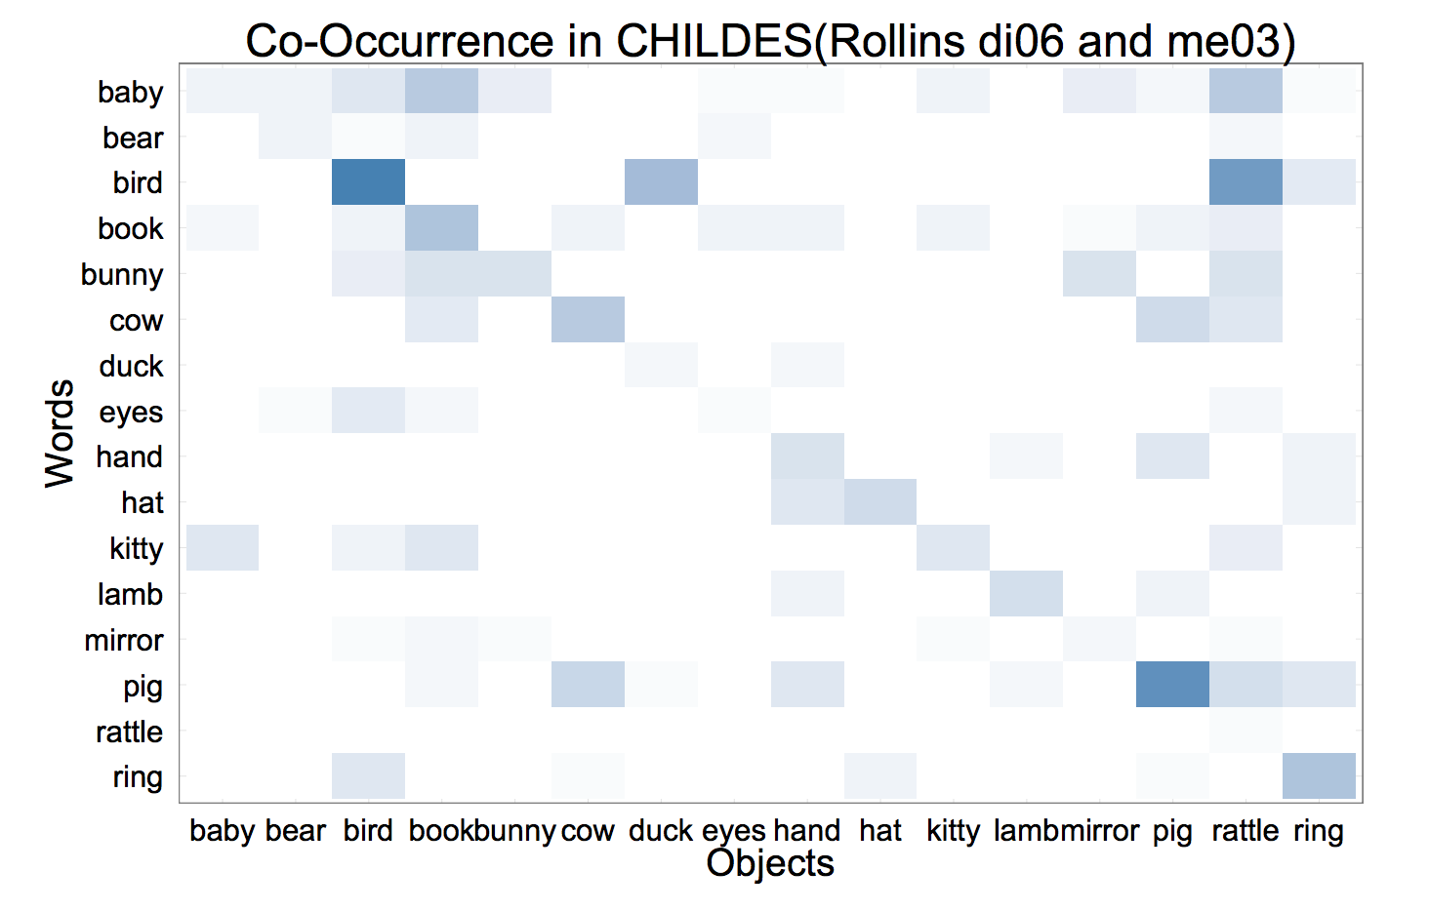
Single-hypothesis tracker
Co-occurrence tracker
BALL
Notes:
The single-hypothesis tracker who makes a strong initial hypothesis and then either verifies or rejects it based on future evidence.
OR the co-occurrence tracker who gradually builds up information about the entire system of word-object co-occurrences.
The critical difference between these two accounts is whether learners are simultaneously acquiring information about multiple candidate referents for the same word.

Slide 16
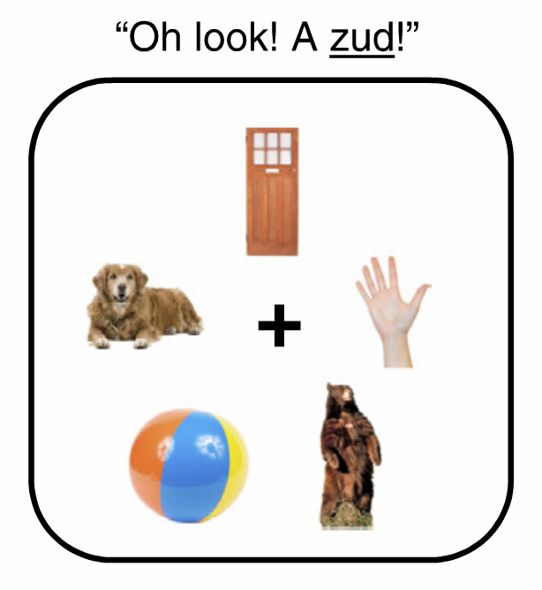
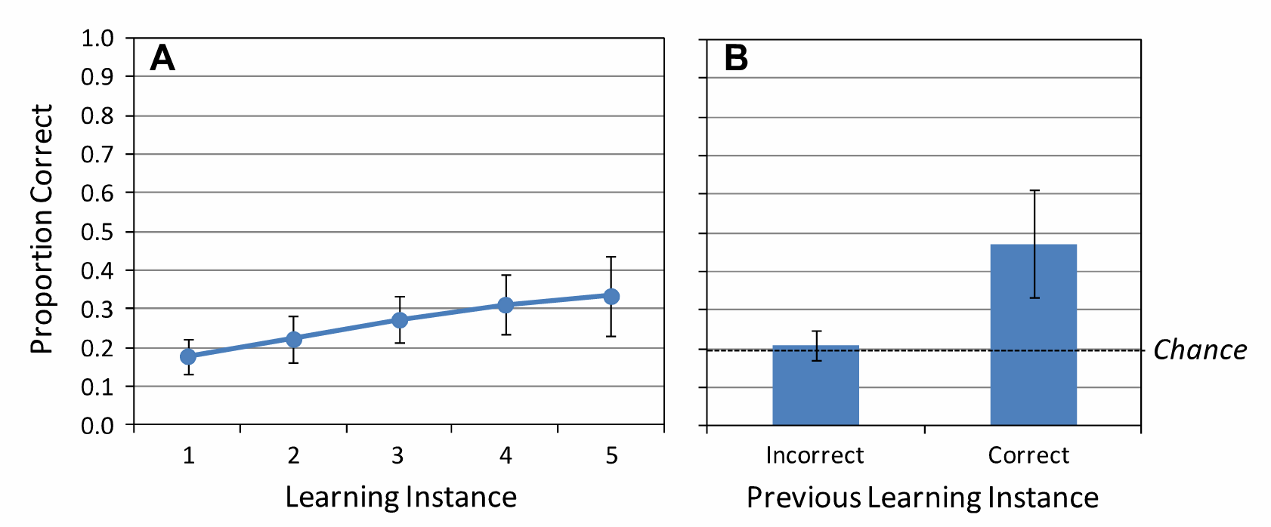
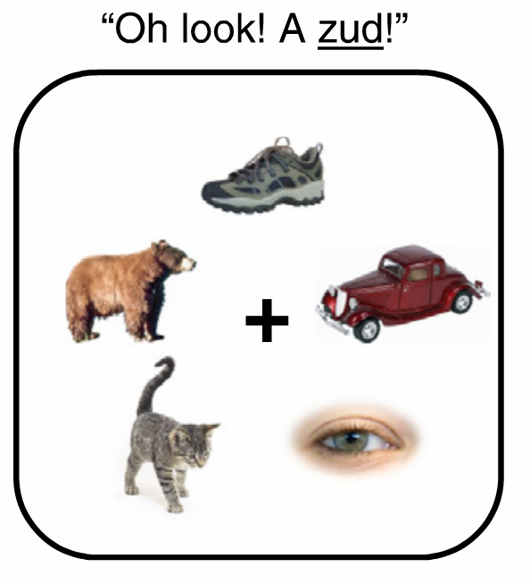
Evidence for single-hypothesis tracking
BALL
Trueswell, Medina, Hafri & Gleitman (2013)
Notes:
Evidence in support of single-hypothesis tracking comes from a couple of studies conducted by John Trueswell and colleagues in which they put learners in a typical cross-situational learning paradigm
They binned trials into two groups – whether you were incorrect or correct on the previous learning instance and with this analysis they found that adults only showed evidence of learning a word-object mapping if they were correct on the previous trial.
So if you didn’t select bear, then you were unlikely to select bear in the next trial even though it had appeared with Zud earlier. However, there is a relatively long delay between exposure and test in these studies, and at lower number of referents on the screen, they do find some evidence from eye-tracking analyses that learners were tracking multiple alternatives.
Further, a recent study conducted by Dan and Mike provides strong evidence that adults and children do track multiple alternatives. And since this paradigm is what I will be building on for my study, I will take some time now to walk through the design and the results from this study.

Slide 17




Exposure Trial
Grink
Same
Switch
Test
Trial
Yurovsky & Frank (under review)
Notes:
First I want to walk through the two different types of test trials. All exposure trials were the same.
Novel words were 1-3 syllable pseudowords obeying the rules of English phonotactics
Novel images taken from Kanwisher, Woods, Iacoboni & Mazziotta (1997)

Slide 18



Yurovsky & Frank (under review)
Notes:
Manipulated the referential uncertainty during exposure by including different numbers of referents.

Slide 19
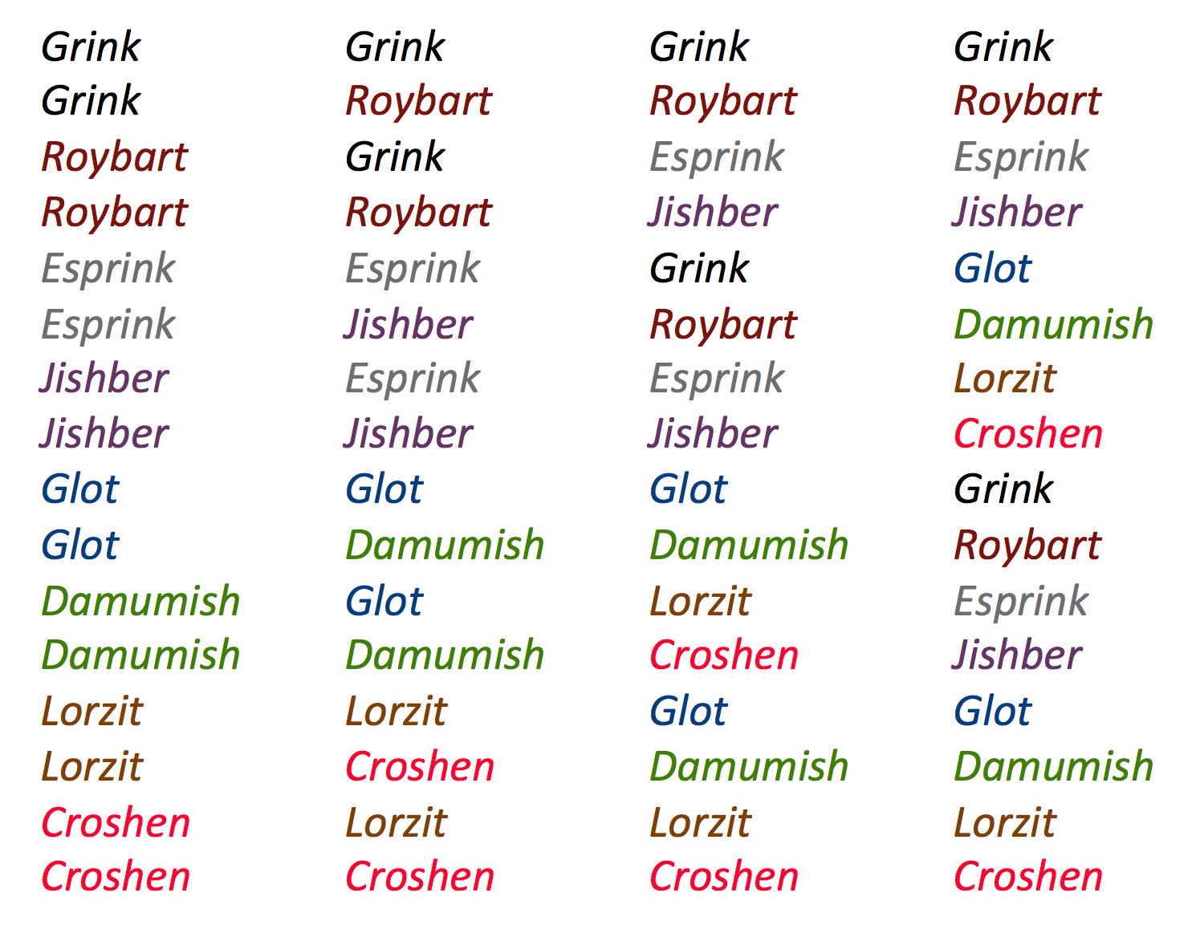
Different delay conditions
Notes:
The delay between exposure and test was also manipulated.

Slide 20
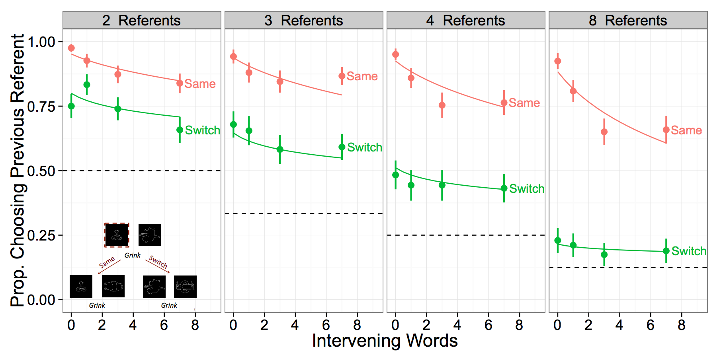
Tracking multiple alternatives at all levels of attention and memory demands
Notes:
Main point from Dan’s work → memory demands matter to representation

Slide 21
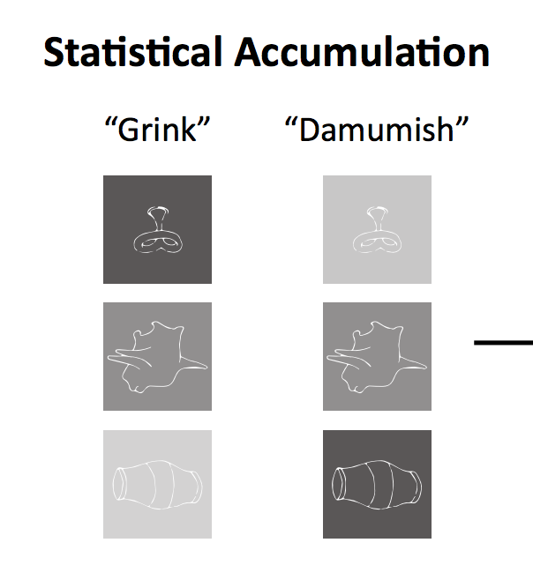
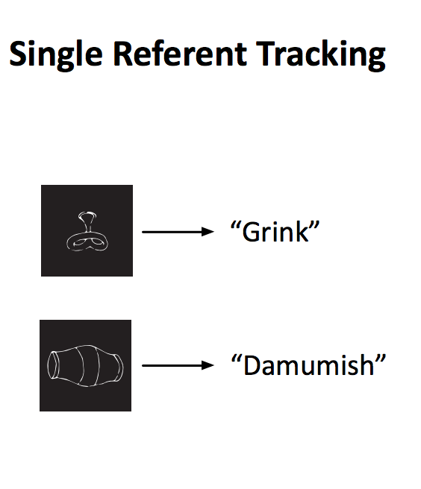
Type of representation is influenced by selection strength
selection strength
Yurovsky & Frank (under review)
Notes:
Learners track both a single target referent and an approximation to the co-occurrence statistics, but the strength of this approximation varies with the complexity of the learning environment

Slide 22
Hypothesis: social information modulates selection strength which could influence the learner’s representation
uncertainty

Slide 23
Roadmap
Different ways to reduce referential uncertainty
Debate about the process underlying cross-situational word learning
A novel, large-scale experiment and computational model

Slide 24

Including social information
“You will meet a speaker named Tina, who
will look at some objects and talk about them.”

Slide 25
Non-social exposure trials
Notes:
Tina always looked straight ahead

Slide 26

Social exposure trials
Notes:
We chose to use eye gaze because it was easy to manipulate and incorporate in the xsl task. We included arrows because piloting tasks showed that participants were struggling to figure out which object Tina was looking at. I don’t want to make any claims about eye-gaze specifically, we just used it blunt instrument to make sure that you are able to see an effect of social information for adults.

Slide 27
All test trials (same/switch) were “non-social”

Slide 28


Slide 29
Different delay conditions
Notes:
The delay between exposure and test was also manipulated.

Slide 30
Large-scale experiment manipulating attention and memory demands in a cross-situational learning task
2400 participants on Amazon Mechanical Turk
8 novel words
Manipulated:
presence of social information
number of referents
number of intervening trials
same vs. switch (within-subjects)
Notes:
Restricted to US IP addresses and > 95% approval rate
Same/Switch trials is a within-subject manipulation
The presence of social information, number of referents, and number of intervening trials were all between-subject manipulations
Now I’ll walk through the behavioral results

Slide 31
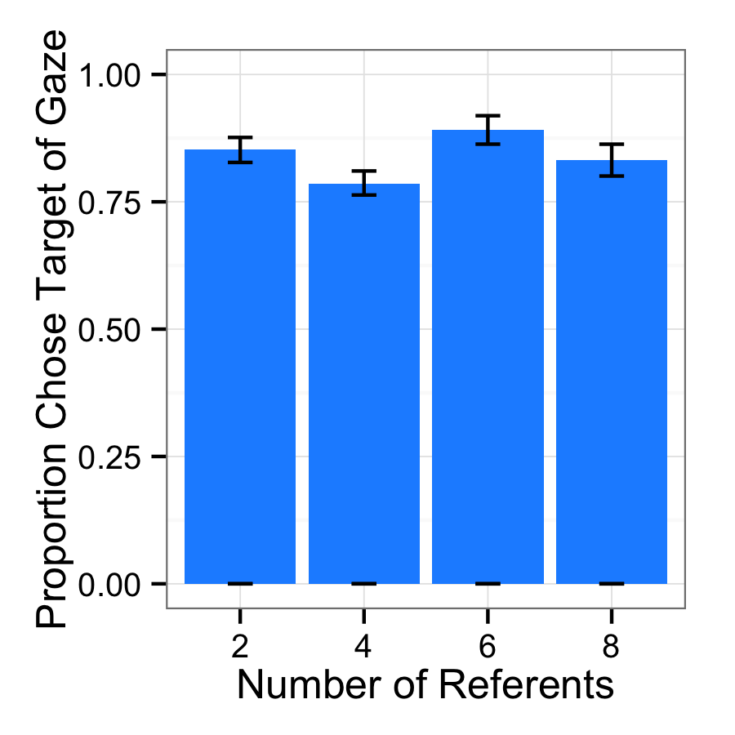
Participants reliably chose the target of eye gaze on exposure trials
Notes:
Manipulation check that participants were using eye gaze as a cue to reference

Slide 32
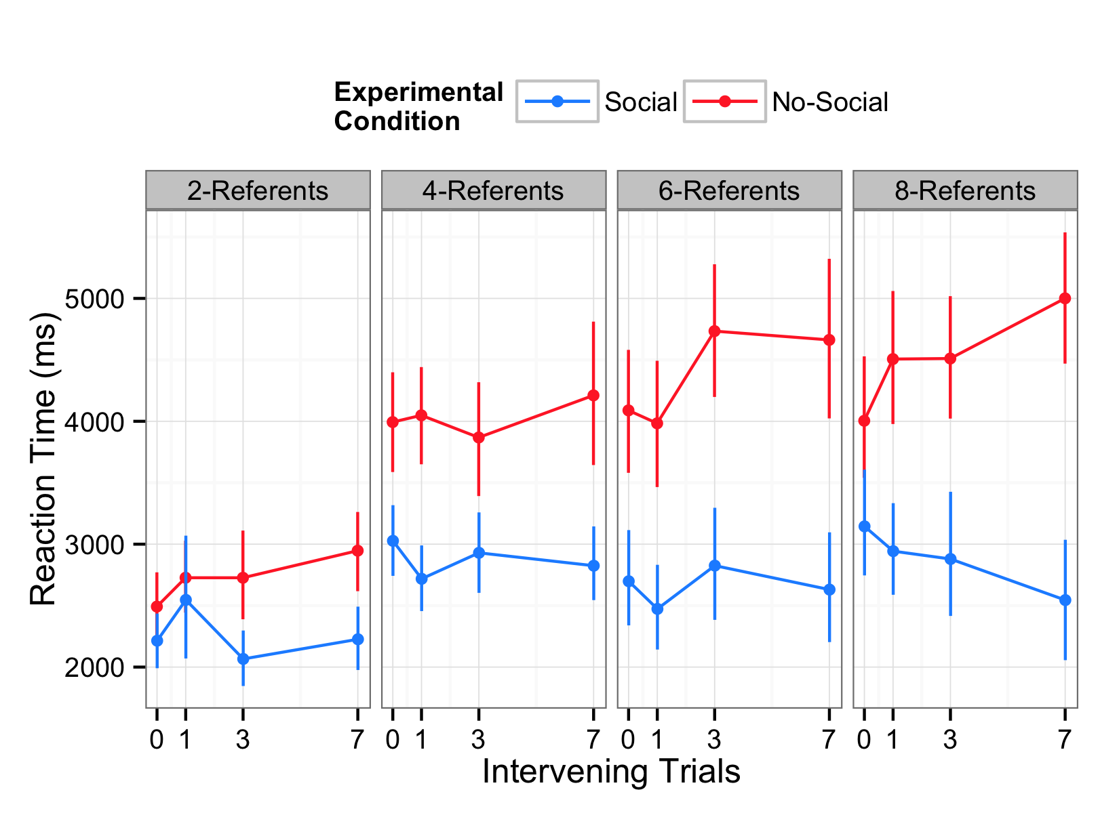
Participants in the Non-social condition took longer to respond on exposure trials
Notes:
Effect of experimental condition – participants responded faster in the social condition.
As the number of referents increased participants took longer to respond, and the difference between social and no-social increased.

Slide 33
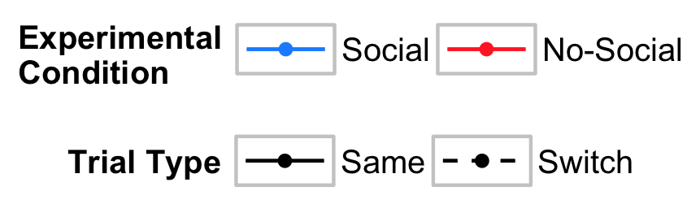
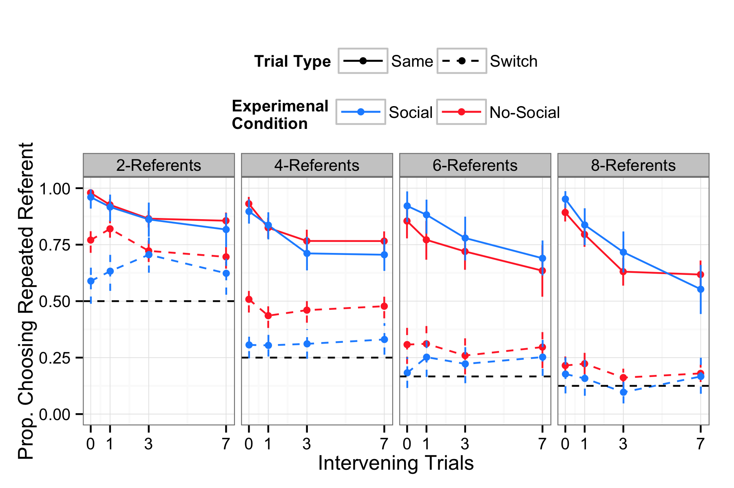
Accuracy
Notes:
Replicate Dan and Mike’s finding that participants track multiple alternatives.

Slide 34
Accuracy
Notes:
Reliable effect of condition on switch trials. Participants were worse in the social condition.
Small effect of condition on same trials at higher numbers of referents. Participants were better in the social condition.
Taken together, this suggests that there is a tradeoff between the presence of social information and learners tracking of multiple alternatives.

Slide 35
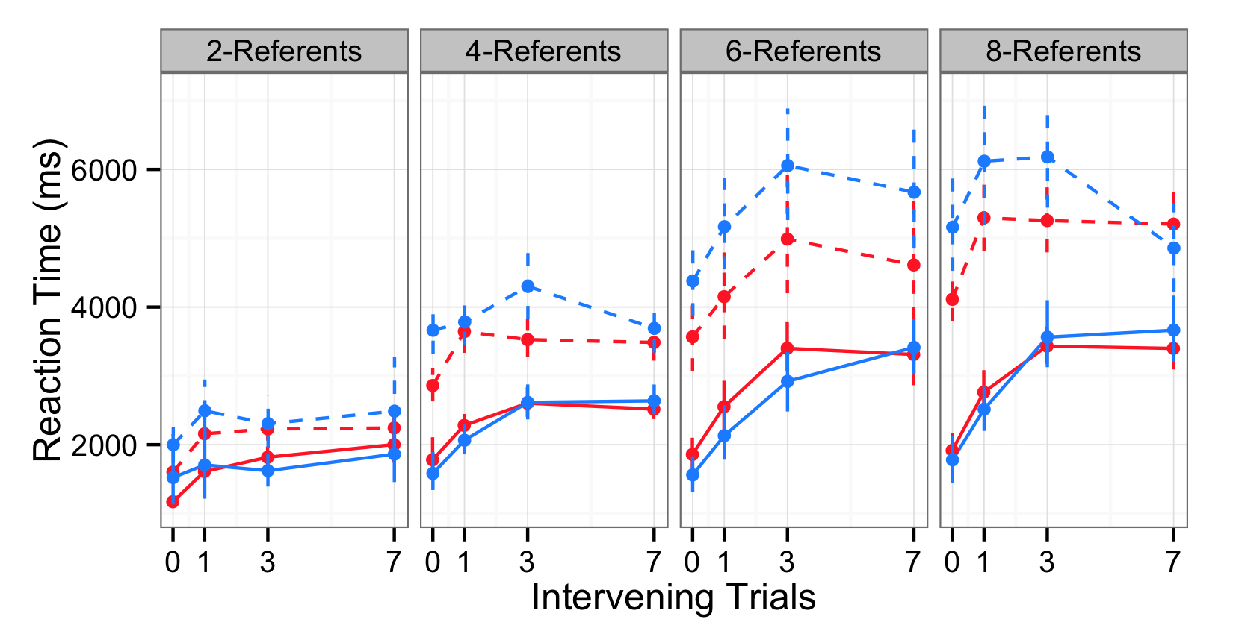
Reaction time
35
Notes:
Orient to axis
See additional evidence that social-switch trials were the hardest – participants took the longest to respond on these trials.

Slide 36
Main findings
Even at a higher level of certainty – i.e., with a social cue – learners still tracked multiple alternatives
Tradeoff between reducing referential uncertainty and tracking alternatives
Some evidence that the influence of social cues interacts with attention demands
Notes:
- make sure you come back to the hypothesis and summarize the results

Slide 37
Roadmap
Different ways to reduce referential uncertainty
Debate about the process underlying cross-situational word learning
A novel, large-scale experiment and computational model

Slide 38
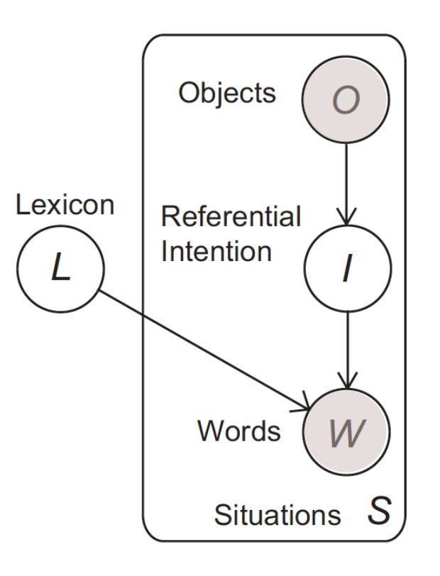
Computational-level model with cognitive constraints
σ → selection
λ → decay
ϒ → encoding
Frank, Goodman & Tenenbaum (2009); Yurovsky & Frank (under review)
Notes:
In this framework, the learner observes a set of situations S with the goal of determining the lexicon of word-object mappings L that produced them P(L|S). Each of these situations consists of two observed variables: objects (O) and words (W). There’s also two unobserved variablse: intention (I) of the speaker and the learner’s task is to infer the lexicon with
Then we add general cognitive constraints,
sigma which captures the inference people make about referential intention of the speaker’s utterance, (can just signpost this step by saying “I’ll say more about this in a second)
gamma which captures the strength of the initial encoding of each object, and
lambda which captures the rate of memory decay over the various delay conditions.
A key parameter in this model is sigma…

Slide 39
Inferring the referential intention
1 - selection
selection
3
Notes:
The idea here is that in an ambiguous learning context the learner makes one selection and decides how much belief to allocate across the referents on exposure

Slide 40
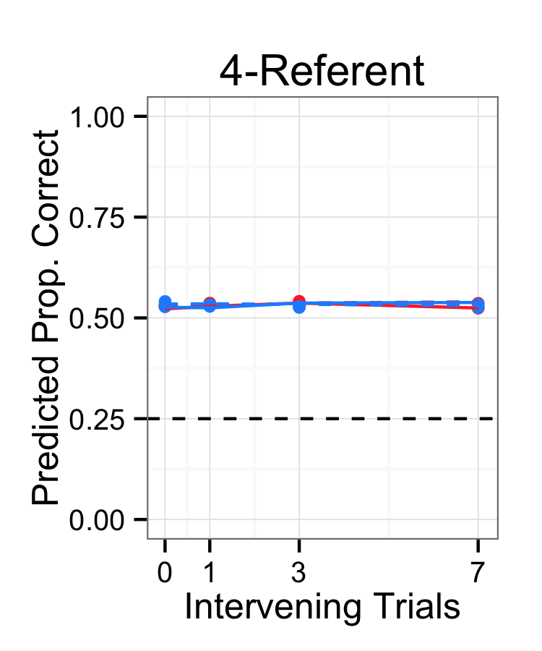
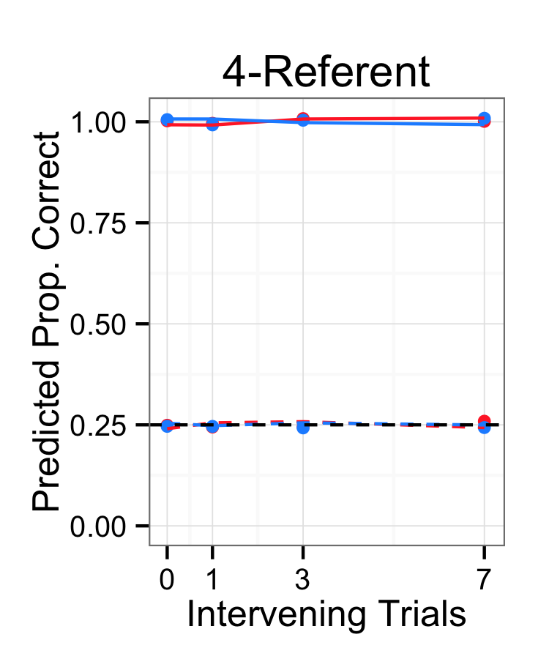
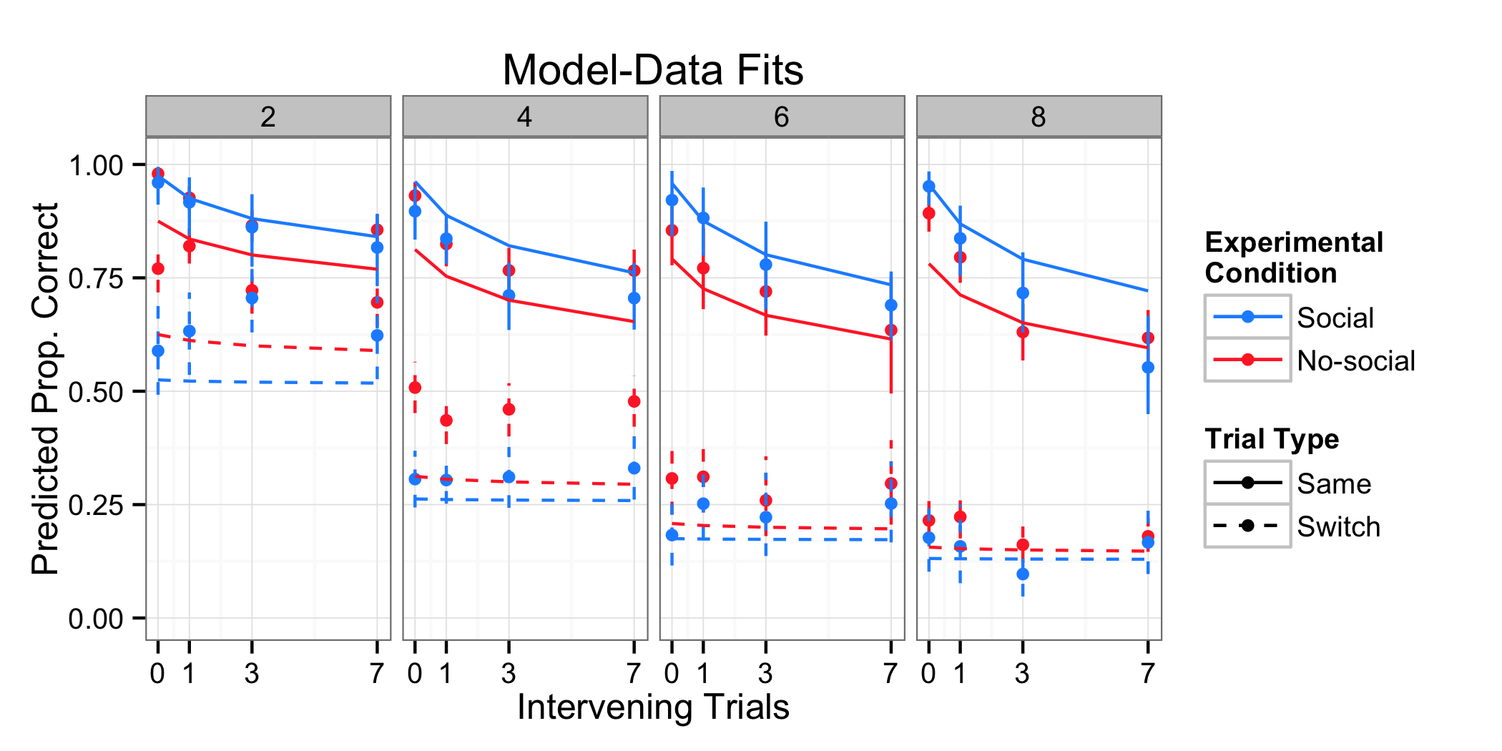
1
selection =
selection = 1
# pics
Notes:
Using this model, we can simulate the optimal single and multiple hypothesis trackers
decay = 0
encoding = 1.5

Slide 41
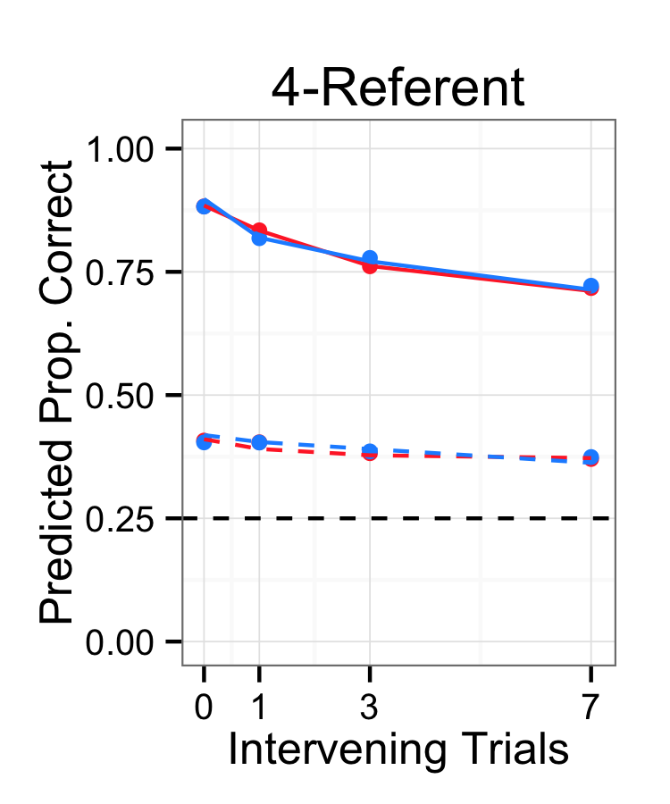
Varying selection, decay, and encoding
selection = 0.57
decay = 0.15
encoding = 1.5
Yurovsky & Frank (under review)

Slide 42
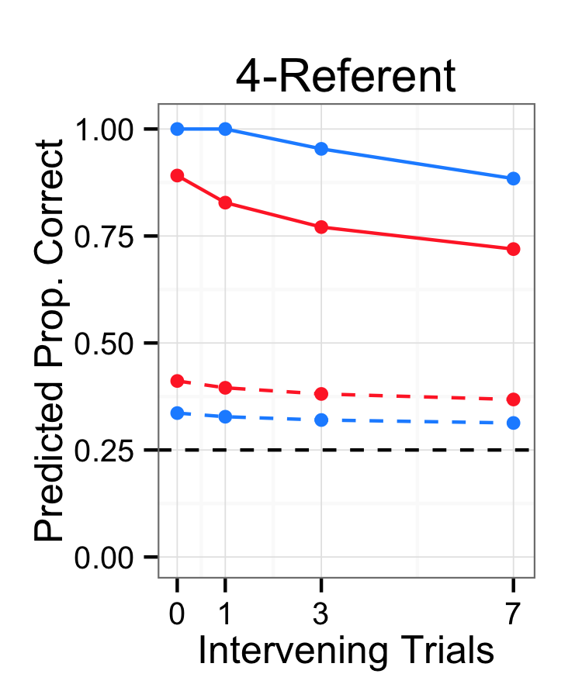
Is social information a boost to selection strength?
selection = 0.57
decay = 0.15
encoding = 1.5
Notes:
use as a tool to make predictions about what social information. is social information doing x, y, and z? interactions?

Slide 43
Notes:
Here is a plot of model to data fit. The model predictions are the colored lines and the human data are the dots with 95% confidence intervals.
Eye-gaze as a “social boost” does capture the main patterns of data – switch cost and social boost. But there does seem to be some complexity that we are not capturing – like the interactions with the number of referents.
This is motivating us to look at other models of what social information is doing during learning.

Slide 44
Alternative models of social information
Spotlights for attention
Information about referential intent
Pedagogical information
Yu and Ballard (2007); Frank et al. (2009); Shafto et al. (2012)
Notes:
Recent computational models attempt to formalize how social and statistical cues can be integrated to facilitate word-learning (Yu & Ballard, 2007; Frank, Goodman, & Tenenbaum, 2009). These models, however, treat social information in fundamentally different ways.
In Yu and Ballard (2007) Unified Model, social information, such as eye gaze or prosody, is characterized as a ”spotlight” that directs the child’s attention to objects in the visual scene. In this account, social cues are considered, but intention reading is secondary to attention and saliency.
(Frank et al., 2009) propose an Intentional model that characterizes social information as providing evidence of a speaker’s referential intent, which in turn facilitates word-learning. This model assumes that the relationship between words and objects is mediated by the speaker’s goals to refer to some object.
Providing information about the sampling process of exemplars.

Slide 45
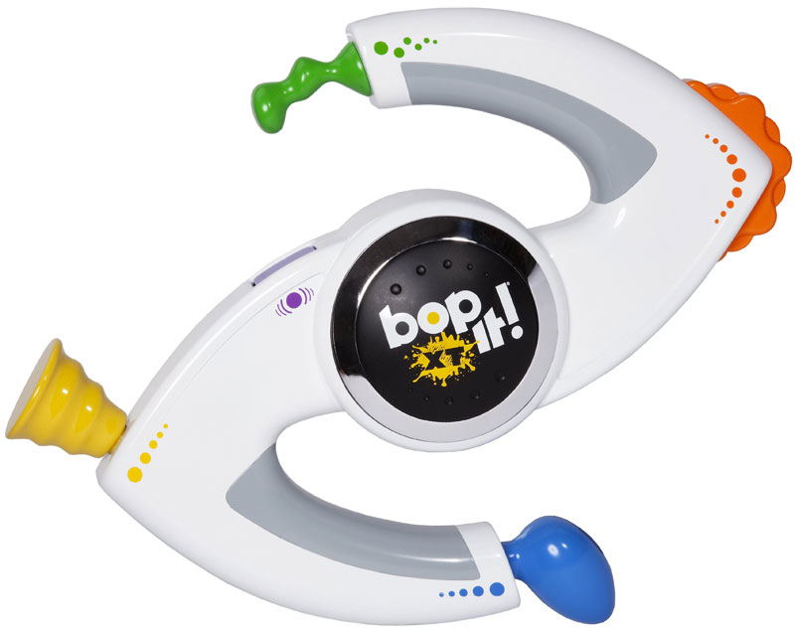
Double-edged sword of pedagogy
Bonawitz et al. (2011)
Notes:
Recent work with older children has explored how presenting information pedagogically changes learners’ behavior. Specifically, Bonawitz and colleagues have shown that when you give children a novel object that has several different functions, and teach one of those functions, then children are less likely to explore and discover alternative functions.
I think this finding and framework maps onto the results of our experiment and simulations

Slide 46
Eye gaze as pedagogical
Notes:
and suggests that we might be able to think of social cues during labeling as being pedagogical, providing information that you should focus your attention on this one and NOT those other ones

Slide 47
uncertainty
Notes:
So returning to the examples that I started with. I hope that I’ve provided evidence that there is a relationship between the amount of referential uncertainty during learning and the type of representations that learners track.
So if your learning moments look more like this, then you might be a co-occurrence tracker. But if they look more like this, then you might be a single referent tracker. I’m excited to explore this interaction in more detail because I think it could have meaningful differences for children’s real world word learning.

Slide 48
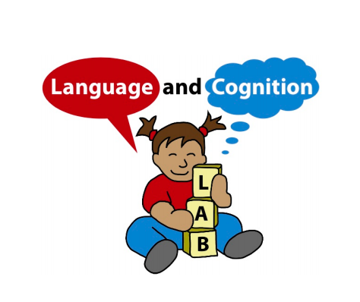
Acknowledgements
Michael Frank
Dan Yurovsky
Frank Lab
Markman Lab
Devostuds
First-year cohort
Thank you for your attention
Notes:
I would like to thank…
And thank you for your attention! Any questions?

Slide 49
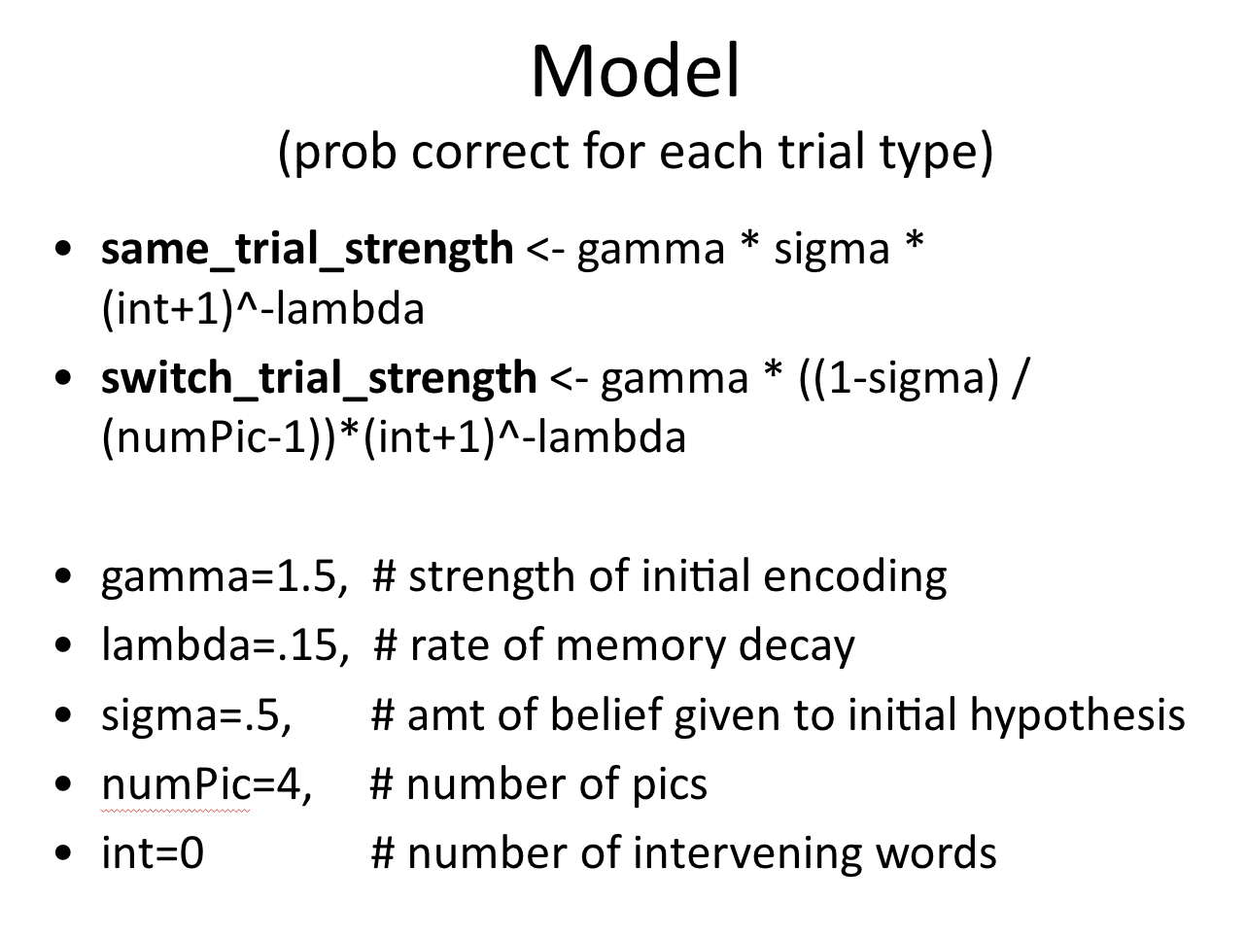

Slide 50
condition intervalNum numPicN freq
1 No-Social 0 2 127
2 No-Social 0 4 114
3 No-Social 0 6 39
4 No-Social 0 8 117
5 No-Social 1 2 120
6 No-Social 1 4 118
7 No-Social 1 6 35
8 No-Social 1 8 114
9 No-Social 3 2 115
10 No-Social 3 4 117
11 No-Social 3 6 36
12 No-Social 3 8 114
13 No-Social 7 2 129
14 No-Social 7 4 115
15 No-Social 7 6 34
16 No-Social 7 8 114
condition intervalNum numPicN freq
17 Social 0 2 48
18 Social 0 4 82
19 Social 0 6 37
20 Social 0 8 43
21 Social 1 2 44
22 Social 1 4 88
23 Social 1 6 44
24 Social 1 8 44
25 Social 3 2 47
26 Social 3 4 87
27 Social 3 6 40
28 Social 3 8 43
29 Social 7 2 47
30 Social 7 4 90
31 Social 7 6 38
32 Social 7 8 38

Slide 51
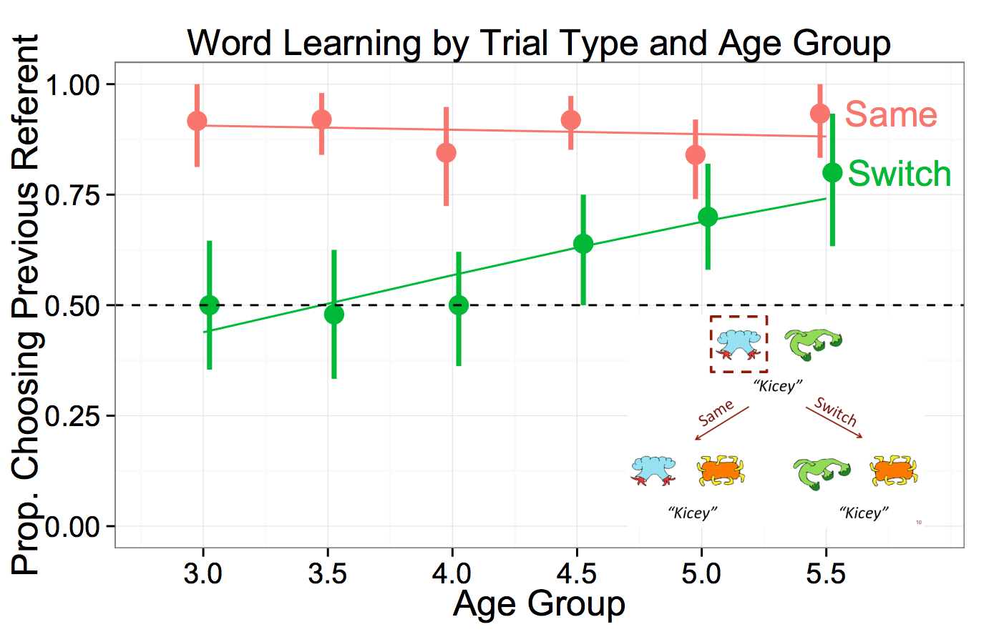
Developmental predictions
Yurovsky & Frank (under review)

Slide 52
Statistical learning at scale
These differences may make
contenders for the label’s referent more memorable
across trials, and they may limit the number of
contenders – even when not clearly indicating the
correct one.
The accessibility of (potentially misleading)
social cues may also differ between the views.
For instance, mother’s gaze does not reliably predict refer-
ence in many naming events (Frank et al., in press).
While analyses of head-camera views suggest that
children access their mother’s gaze infrequently (Fran-
chak, Kretch, Soska & Adolph, 2011; Smith et al.,
2011), the third-person view makes gaze more readily
available.

Slide 53
Infants track statistics in the input,
create a co-occurrence matrix, and learn the meaning of “truck” over time
“Truck”
“Ball”
“Truck”
Truck
2 | 1 |  | 1
 | 1 | 1
Time
Ball
Notes:
Trueswell & Medina, 2012
Yurovsky & Frank, under review

Slide 54
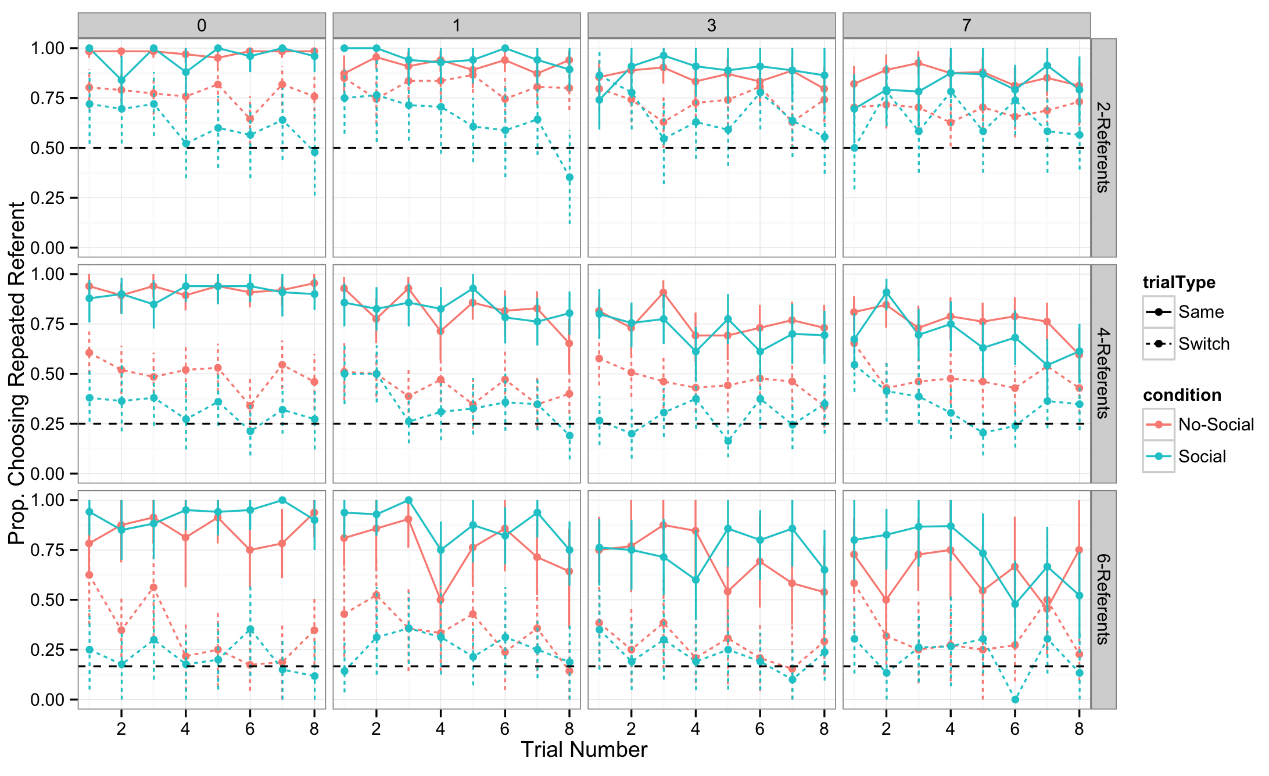
Order Analysis

Slide 55
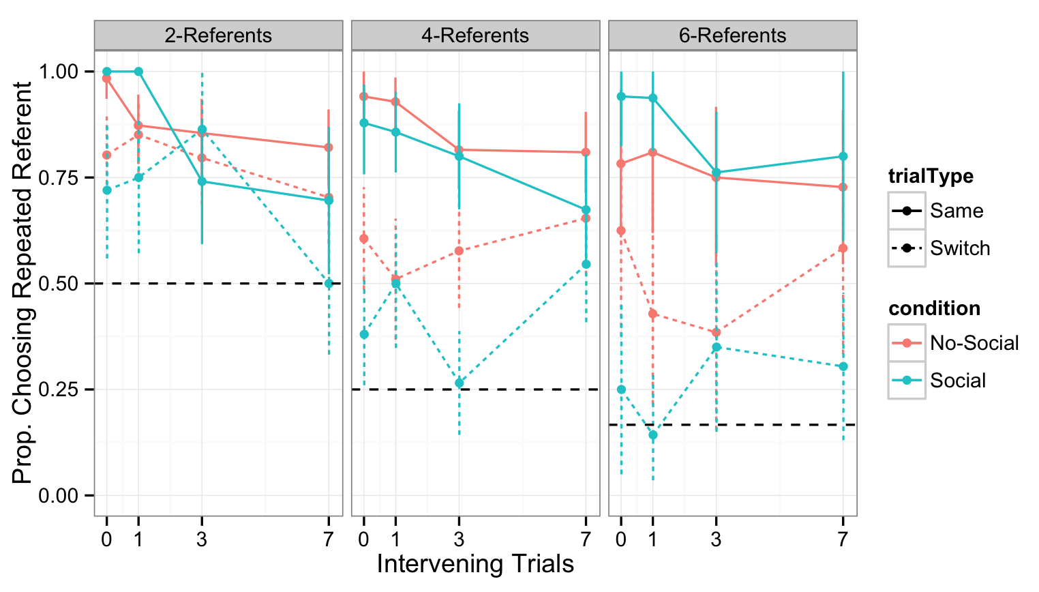
First trial analysis

Slide 56
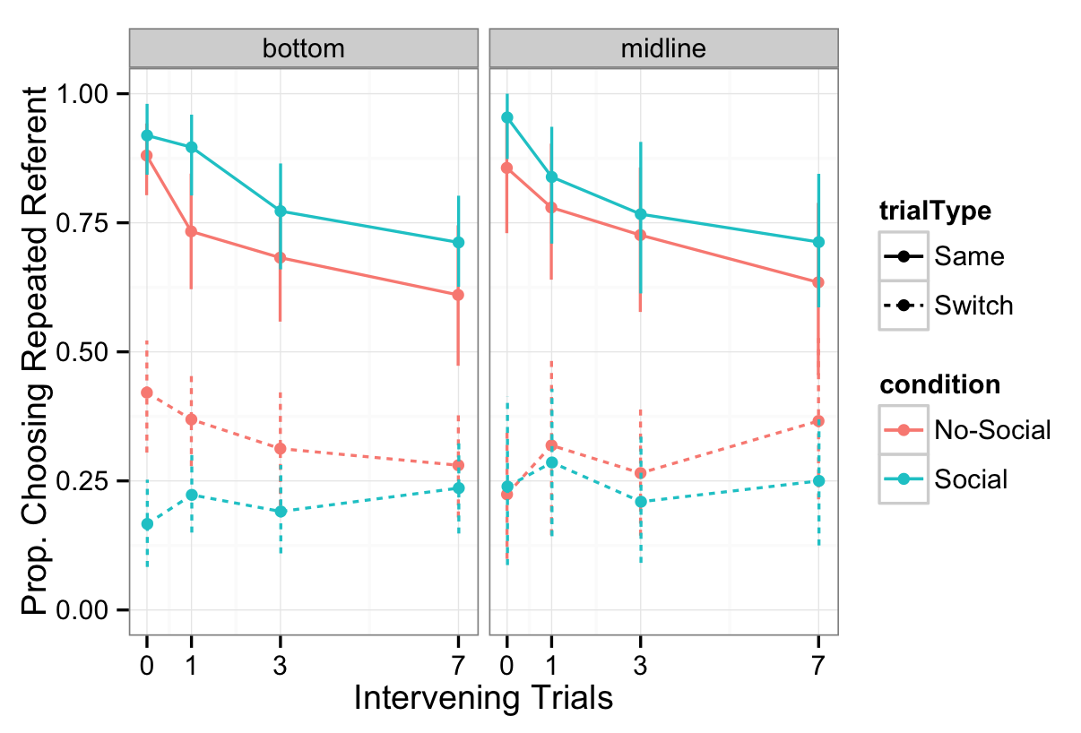
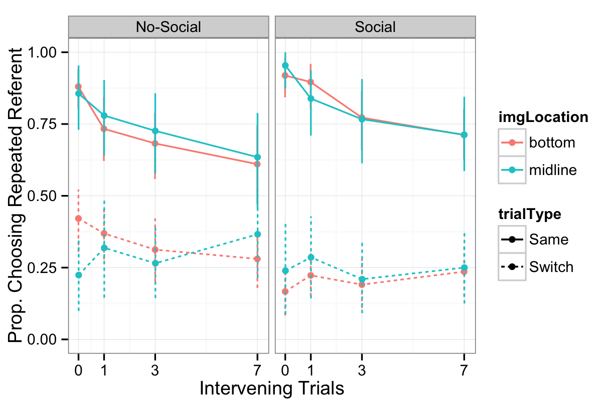
In the 6-referent condition, image location (bottom/midline) does not change the results

Slide 57
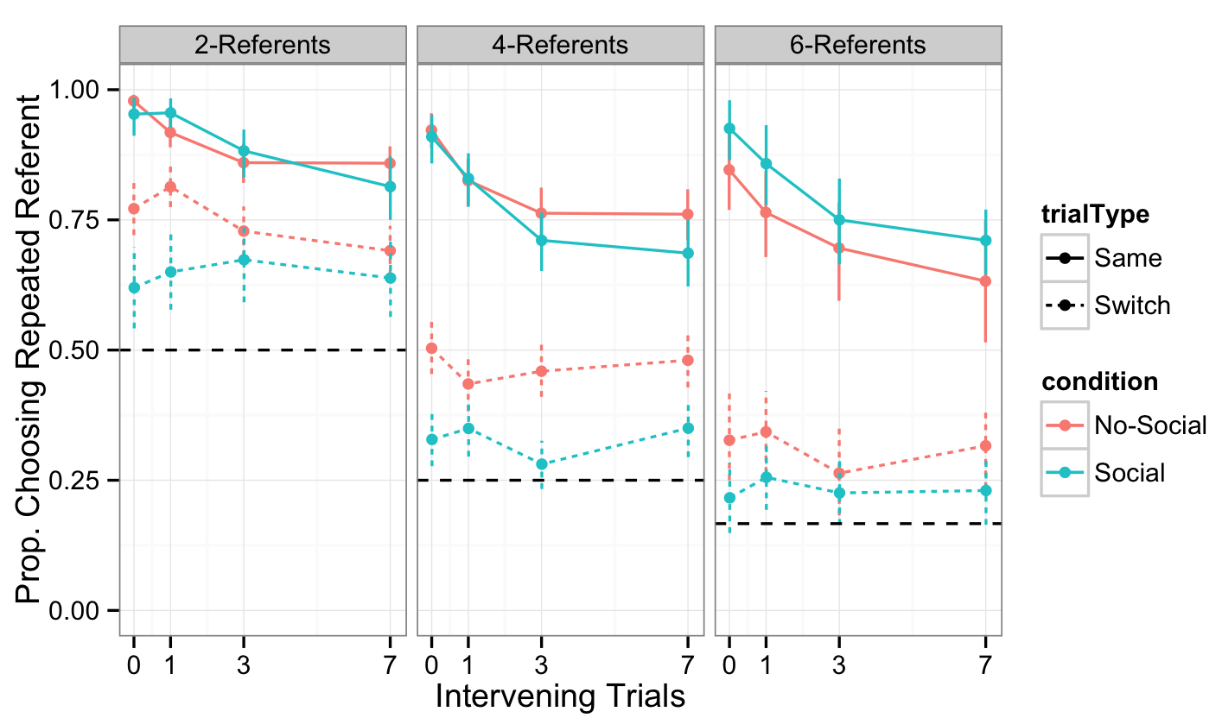
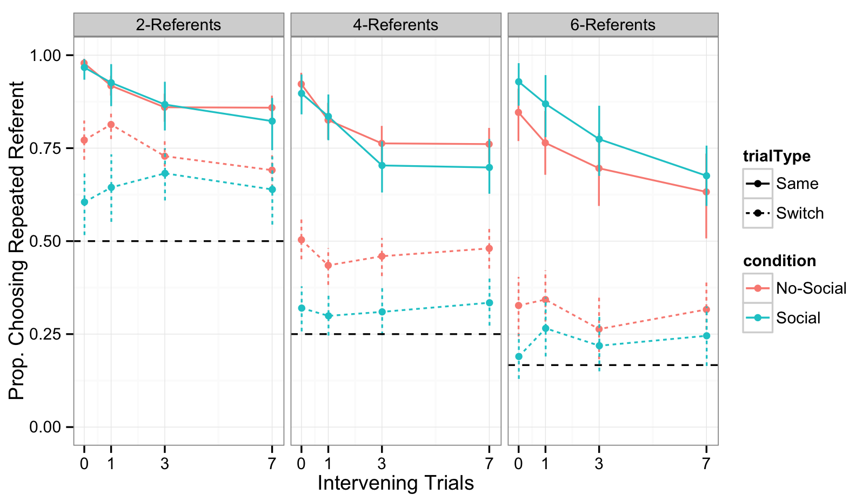
Removing trials on which subjects failed to choose the target of eye gaze does not change results

Slide 58
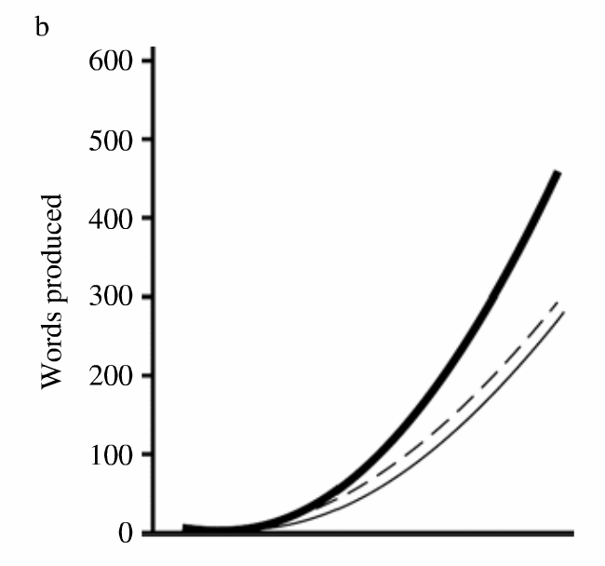
Correlational data shows that gaze-following at 10 months predicts faster vocabulary growth
Brooks & Meltzoff (2008)
Notes:
Correlational data show that intention reading skills, as indexed by gaze following ability, predicts faster vocabulary growth.
The thick, solid line represents strong gaze-followers at by the adult ( + 1 SD average duration of
correct looking). The thin, solid line represents the weak gaze-followers (- 1 SD below average). The dashed line is the 50th
percentile of the CDI.
there is sufficient evidence that rich, social interactions are high in information value and facilitate early word-learning. However, these episodes make up only a portion of the word-learning contexts that young children experience, even those growing up in the most supportive of households (Frank, Tenenbaum, & Fernald, 2013). Also, children can learn words from overhead speech and without experiencing much direct social interaction with adults (Shneidman & Goldin-Meadow, 2012).
Can children solve the problem of reference without correlated social cues?

Slide 59
Researchers debate about the underlying processes that support cross-situational word learning
Smith, Suanda & Yu (2014)

Slide 60
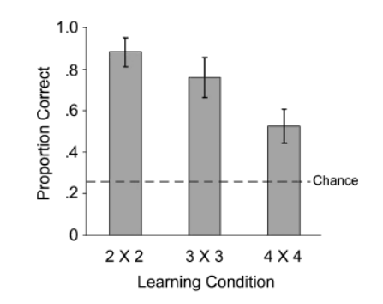
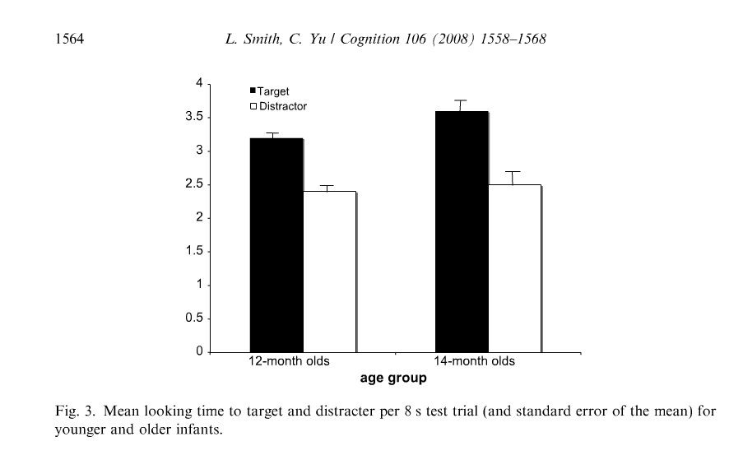
Experimental work shows that both adults and infants can learn novel words from co-occurrence information
2 | 1 |  | 1
 | 1 | 1
Adults
Infants
(Yu & Smith, 2007)
(Smith & Yu, 2008)
Notes:
Adults (Yu & Smith, 2007) and infants (Smith & Yu, 2008) were exposed to small artificial lexica that contained cross-situational regularities across trials. Both groups successfully learned the word– object linkages from this alone, with adults showing evidence of learning even in highly ambiguous conditions. These results provide an important proof of concept, that statistical or associative learning may proceed without solving referential ambiguity in the moment via social cues.
Also, Computational models suggest that XSL can be used to accurately infer the meanings of words from small but realistic corpora of language use (Frank, Goodman, & Tenenbaum, 2009; Siskind, 1996; Yu, 2008; Yu, Ballard, & Aslin, 2005), and other researchers have shown mathematically that XSL can allow large, language-scale lexicons to be learned in the face of considerable referential uncertainty (Blythe, Smith, & Smith, 2010).
So there seems to be strong experimental and correlational work suggesting that social cues facilitate word learning. And there is experimental and modeling work to support the plausibility of cross-situational learning.

Slide 61
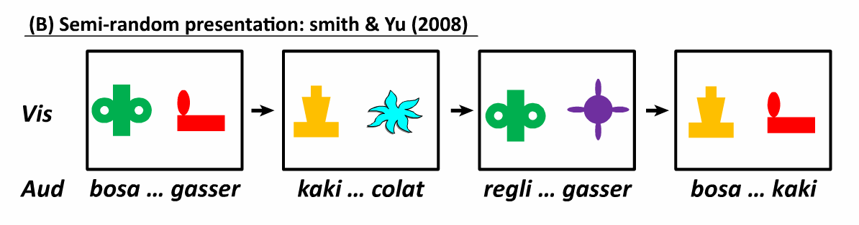



Infants track statistics in the input,
create a co-occurrence matrix, and learn the meaning of “bosa” over time
bosa
regli
kaki
gasser
colat

Slide 62

Same trials
Exposure Trial
Test Trial
Notes:
Focusing on the role of social information during initial exposure to word-object mapping
My experiment is not really xsit learning, but one shot exposure.
So really exploring the role of social cues in the inferences that learners’ make during initial bouts of learning (referent selection)

Slide 63
Switch trials
Exposure Trial
Test Trial
Notes:
Focusing on the role of social information during initial exposure to word-object mapping
My experiment is not really xsit learning, but one shot exposure.
So really exploring the role of social cues in the inferences that learners’ make during initial bouts of learning (referent selection)

Slide 64
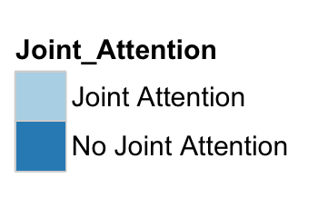
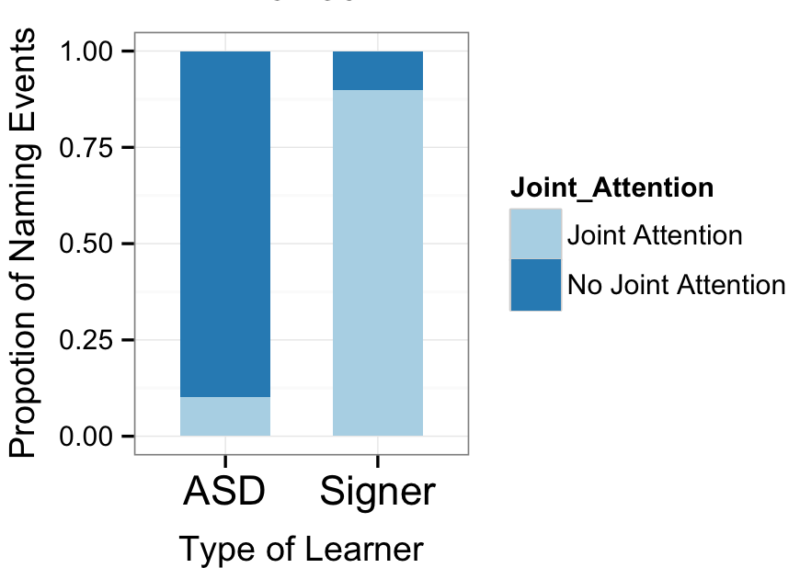
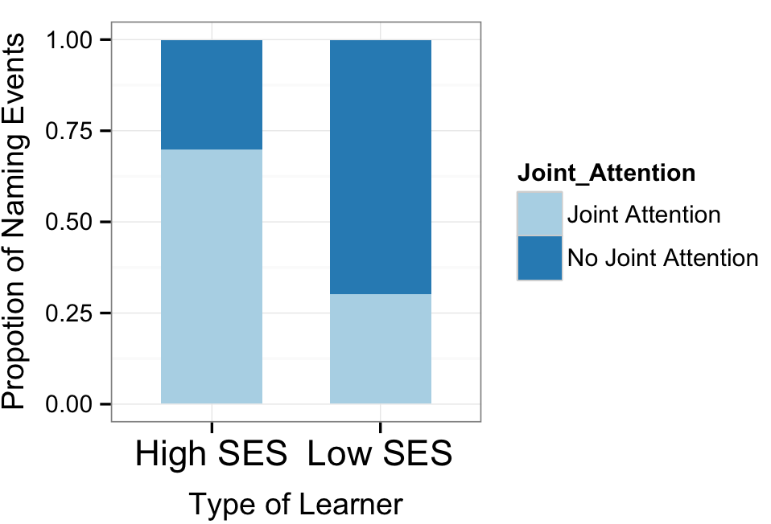
Learners might experience a different proportion of their naming events under uncertainty

Slide 65
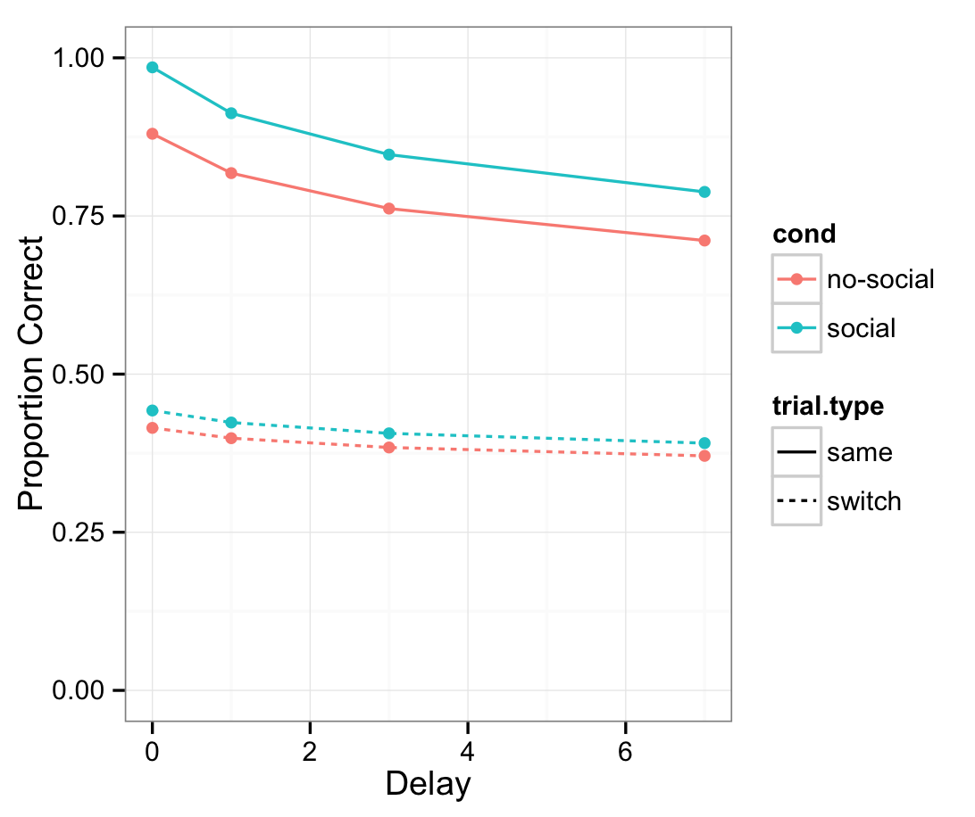
Is social information a boost to gamma?
σ = 0.57
ϒ = 1.5
λ = 0.15

Slide 66
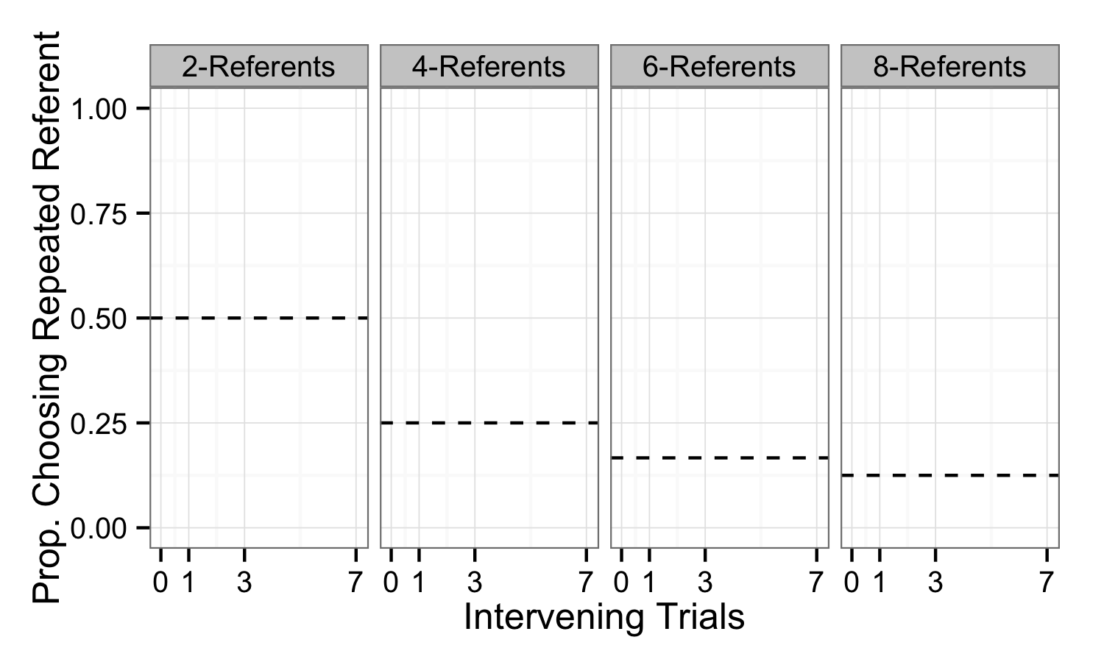
Notes:
First, I want to orient you to the graphs that I will show. Here we are plotting proportion choosing the repeated referent as a function of the number of intervening trials. The panels are different number of referents on exposure. Social points and lines will be blue and non-social will be red. Same trials are plotted with a solid line and switch with a dashed line. Here’s chance lines 1/number of referents.
And all error bars are 95% confidence intervals

Slide 67
Exposure
Test
0
1
3
7
Number of Intervening Words

Slide 68
Exposure
Test
0
1
3
7
Number of Intervening Words

